Slide 1





Geospatial Monitoring System for Air and Water Quality Index
Ministry/Organization Name :Government of Kerala
PS Code:SIH1324
Problem Statement Title : Air and water quality index and environment monitoring
Team Name : Elite squad
Team Leader Name : M. Karthik
Institute Code (AISHE):U-0474
Institute Name : Sathyabama University
Theme Name : EnviroMonitor

Slide 2
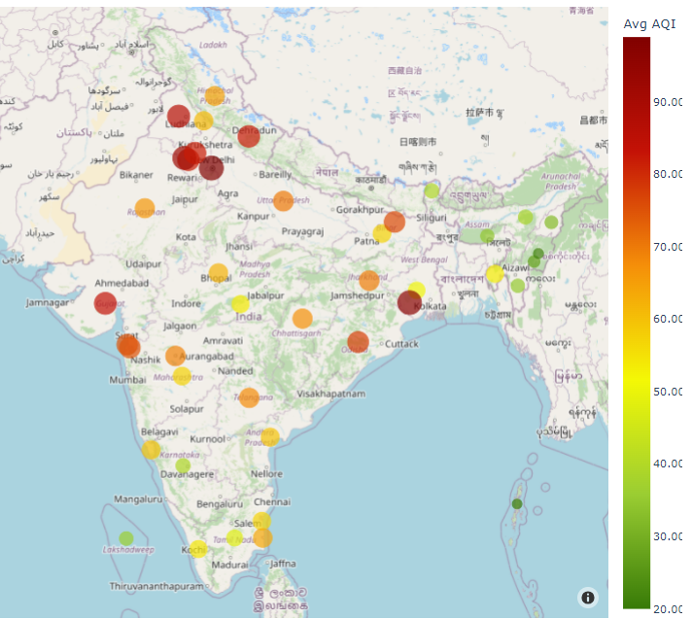
IDEA/APPROACH
The Geo-spatial monitoring system for air and water quality index is a comprehensive project aimed at monitoring and visualizing air and water quality index at a specific geographical location.
The project aims to provide real-time environmental data to empower residents, researchers, and authorities for informed decision-making and environmental conservation.
The idea is to develop an integrated Air and Water Quality Monitoring System that leverages advanced sensor technology and data analytics to provide real-time, accurate, and accessible information about the quality of air and water in a specific region.

Slide 3
Deployment
Use Cases :
Technology stack :
Public Health and Safety
Environmental Protection
Urban Planning and Infrastructure
Industrial and Agricultural Applications
Emergency Response
Research and Innovation
Real time monitoring
Colab
Pandas
Matplotlib
Seaborn
ML Algorithms - Lstm,knn,EDA
Bs4 - beautifulSoup
Requests
ThreadPoolExecutor
Folium
Timeseries models

Slide 4

Dependencies
Showstoppers:
Data Availability
Sensor Technology
Data Infrastructure
Government and Regulatory Support:
Community Engagement:
Technology and Expertise:
Funding
Data Quality and Reliability
Privacy and Security Concerns.
Regulatory Challenges
Infrastructure Limitations
Resource Constraints
Resistance to Change
Environmental Catastrophes
Data Interpretation Challenges
Lack of Public Awareness
Climate and Weather Variability

Slide 5
Team Member Details
Team Leader Name: M. Karthik
Branch :B.E Stream :CSE (IOT) Year : III
Team Member 1 Name: D. Bala Chandu
Branch :B.E Stream :CSE (IOT) Year : III
Team Member 2 Name: R. Durga Naga Prasad
Branch :B.E Stream :CSE (IOT) Year: III
Team Member 3 Name: P. Pavan Teja
Branch :B.E Stream :CSE (IOT) Year :III
Team Member 4 Name: K. Jithendar
Branch :B.E Stream :CSE (IOT) Year :III
Team Member 5 Name: K. Sujitha
Branch :B.E Stream :CSE (IOT) Year :III
Team Mentor 1 Name: Dr. D. Menaka
Academic Expertise (DL/IoT/Data science) Domain Experience (5 Years)
Team Mentor 2 Name: Dr. T. Naresh Kumar
Academic Expertise (AI/ML/ Robotics) Domain Experience (10 Years)

